Slide 1
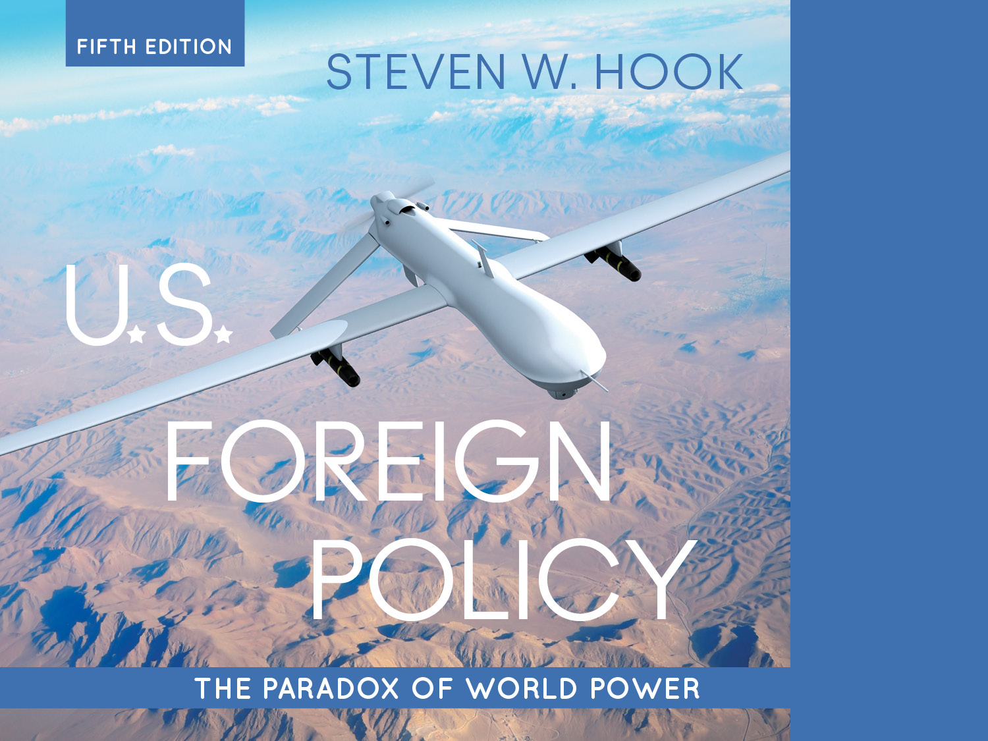
3. Dynamics of Decision Making

Slide 2
Today’s Agenda:
Finish discussion of public opinion, media and democratic governance
Discuss role of theory in international politics
Identify three mainstream theories
Realism
Liberalism
Constructivism
Discuss the role of domestic politics (e.g. bureaucracy) in foreign policy making
Discuss role of psychology in foreign policy decision making

Slide 3
Chapter objectives:
Summarize the three theories with assumptions about the international system that inform US foreign policy decision making
Identify key arguments in the “black box” debate
Describe the three spheres of political activity and their importance in FoPo making
Identify the ways in which US civil society participates in FoPo making (civil society, gov’t institutions, bureaucracy).
Discuss the influence of human psychology on the making of US FoPo

Slide 4
The Dynamics of Decision Making
Questions to be answered:
How do international relations theories help us understand the global context of foreign policy?
What happens, how does it happen, why does it happen?
How can we understand the role of domestic actors and domestic politics?
Why do agencies and bureaucracies shape behavior the way they do?
Why do policy actors behave the way they do? The Human Factor.
Notes:
Talk about parsimony and explanatory power here, rendering complex issue more comprehensible.

Slide 5
The Global Context: Rival Perspectives
Three rival perspectives: structural realism, liberal theory, and constructivism
Assumptions of structural realism
Focus on anarchical structure of global politics
Focus on sovereignty and state power (1648 Treaty of Westphalia)
Importance of geography and access to resources (geopolitics)
States have national interests and are rational unitary actors
States are in a constant security dilemma, seek parity or power over other states (i.e. balance of power politics).
Problem: lack of balancing behavior against the U.S.?
Notes:
Learning Objective: 3.1

Slide 6
The Global Context: Rival Perspectives
Assumptions of liberal theory (and global governance)
Liberalism: Even though no world government exists, there is world governance
Emphasis on norms: Shared democratic values
Enlightened self-interest: Positive traits of human nature
Relative peace: Most states are at peace most of the time
Two-level games: Domestic and international interests coalesce
Theory underpinning LIO
Notes:
Learning Objective: 3.1

Slide 7
The Global Context: Rival Perspectives
Neoliberal institutionalism: Focus on institution building and repeated cooperation between states
Kant’s Democratic Peace Theory: Democracies do not go to war with each other
Interdependence: Countries are increasingly enmeshed in multilateral institutions and relations
Interstate cooperation is result of repeated interactions
Emphasizes importance of transnational institutions
Notes:
Learning Objective: 3.1

Slide 8
The Global Context: Rival Perspectives
Foreign policy in a constructed world
Assumptions of (social) constructivism
Constructivism: Politics and foreign policy are socially invented, primarily through public discourse
Perceptions of reality, norms, identities, and behavior are subjective
Identity matters!
Rhetoric and creation of institutions further deeper political objectives
Examples: “axis of evil,” manifest destiny, NATO, and “rogue states”, 9/11
Notes:
Learning Objective: 3.1

Slide 9
Theories Applied:
Different theoretical perspective used to understand certain developments and problems in international politics can yield vastly different policy prescriptions.
For example how should the US respond to China’s rise as a global super power?
Realists, Liberal IR, Constructivists?

Slide 10
Opening the “Black Box”: Foreign Policy as Rational Action?
The “black box” of domestic politics
The internal competition and bargaining among societal interest groups, government agencies, and individual policy makers with a stake in policy outcomes
Structural realism
Disinterested in opening the black box in foreign policy analysis
State is a unitary actor
Decisions made by rational actors (self-evident goals)
Game theory provides testable models
Notes:
Learning Objective: 3.1

Slide 11
Opening the “Black Box”: Foreign Policy as Rational Action?
Other approaches (liberalism and constructivism) strongly disagree:
Opening the black box is a must
Reveals fragmented centers of decision making
Actors are not unitary or rational
Bounded rationality (incomplete information) constrains choices
Policymaking is uncertain due to difficulty of cost-benefit analysis
Images, threats, and identities are created at the domestic level (constructivism)
Notes:
Learning Objective: 3.1

Slide 12
Opening the “Black Box”: Foreign Policy as Rational Action?
In the study of U.S. foreign policy: Blended approach
Located at the intersection of three spheres of political activity
Transnational civil society
The interstate system
Domestic governing institutions

Slide 13
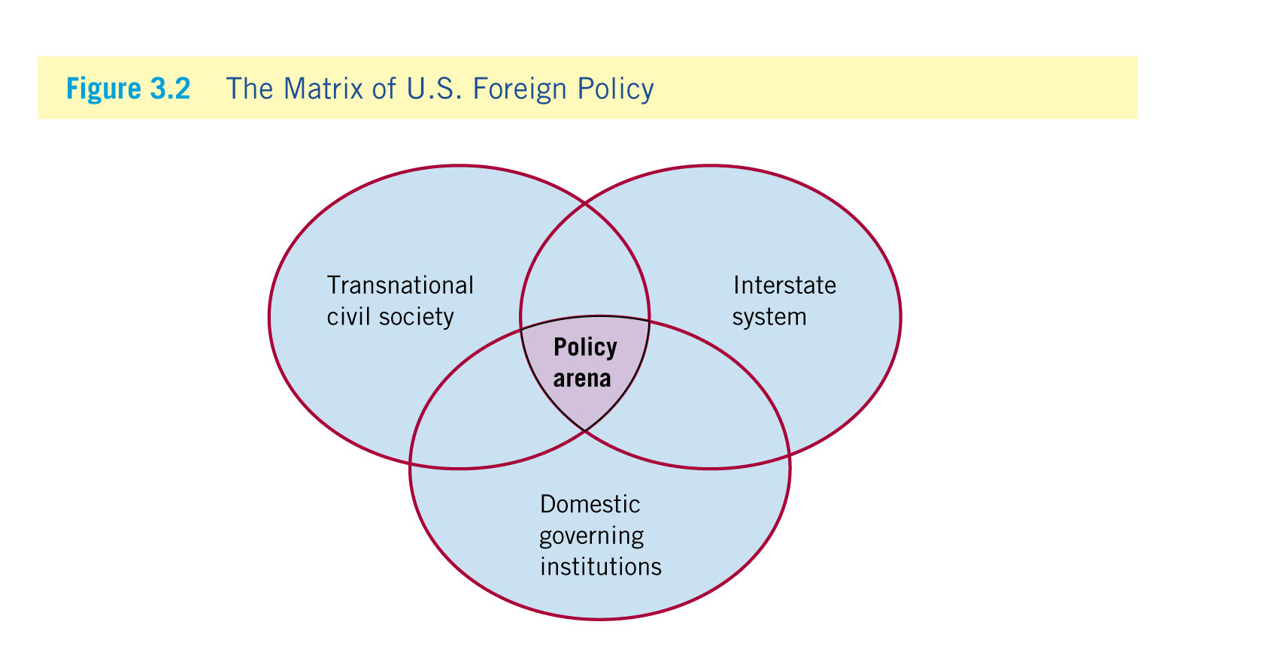
Opening the “Black Box”: Foreign Policy as Rational Action?
Notes:
Learning Objective: 3.2

Slide 14
The Impact of Civil Society
Iron triangle: A policy subgroup that controls the agenda and policy-making process for a policy area
Institutional setup that allows interest groups into the process
Long-standing relationships impenetrable to outside influences (“iron”)
Includes interest group, congressional committee, and executive branch agency (“triangle”)
Example: Military-industrial complex (Lockheed Martin and General Dynamics—fighter jet and weapons contracts)
Notes:
Learning Objective: 3.3

Slide 15
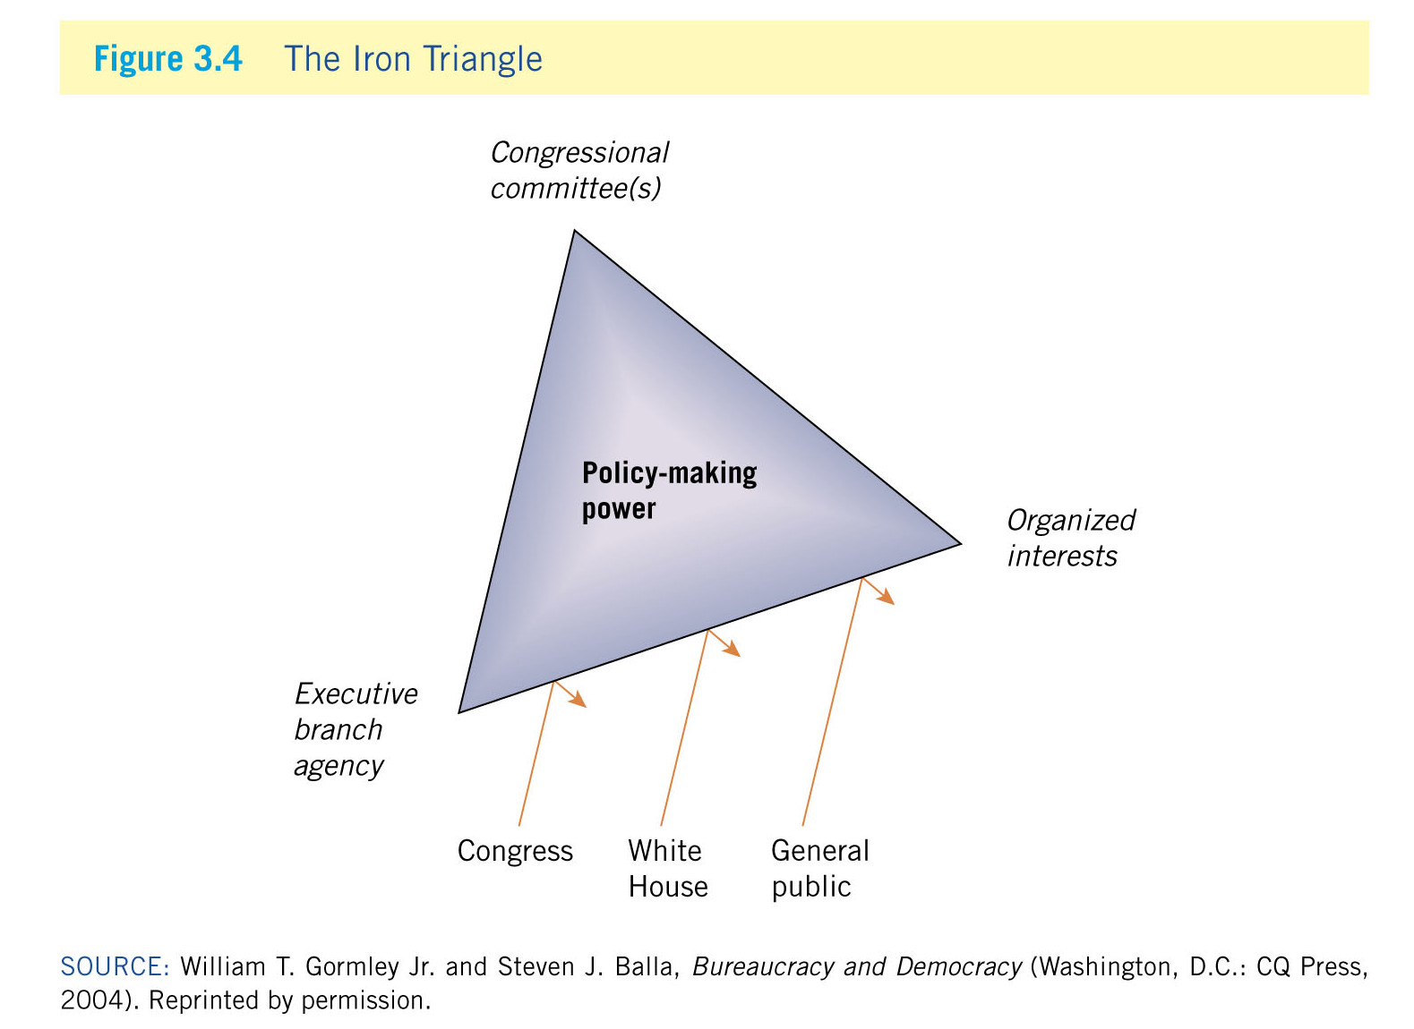
The Impact of Civil Society
Notes:
Learning Objective: 3.3

Slide 16
Coping with Bureaucratic Politics
Patterns of organizational behavior
Resilience
Long-lasting nature of organizations: Difficult to change the status quo
Autonomy
Independent nature of agencies: Difficult to penetrate from the outside
Self-interest
Existence of agency preferences: Competition between agencies for resources, power, and prestige
Notes:
Learning Objective: 3.4

Slide 17
The Human Factor
Beliefs and cognitive “shortcuts”
Belief systems
Individual worldviews, formed early in life (and difficult to change), that influence foreign policy goals, strategies, responses to problems
Policy making is not always rational
Bounded rationality: Cognitive and structural limits on policy makers
Notes:
Learning Objective: 3.5

Slide 18
The Human Factor
Types of beliefs and their combination
Principled beliefs: Structured perceptions toward political problems; informed by concerns for principles such as liberty, justice, equality
Causal beliefs: Perceptions that an individual decision-maker holds regarding likely functional links among policy problems, their sources, alternative solutions
Principled beliefs and causal beliefs combine to form an operational code: Integrated set of conceptions about political life that forms an individual’s calculations of appropriate/effective policy
Notes:
Learning Objective: 3.5

Slide 19
The Human Factor
Cognitive psychology: The process by which individuals understand the world around them
Cognitive consistency: The common, subconscious tendency of individuals to perceive new information as consistent with their existing belief systems
Selective perception: The process by which people tend to seek out information that reinforces their worldviews while ignoring contradictory information
Use of analogies: Using historical precedents to match new experiences with stored memories
Notes:
Learning Objective: 3.5

Slide 20
The Human Factor
[Cognitive psychology (con’t.)]
Cognitive closure: The adopted conception of a problem before all the available information has been examined fully and alternative strategies considered
Bolstering: Once a decision is made, policy makers use that decision to “bolster” or support their initial argument regarding the problem at hand
Notes:
Learning Objective: 3.5

Slide 21
Conclusions:
Take-away from today: When it comes to Foreign Policy and International Relations Theory, we focus on two broad questions:
(1) does domestic politics matter in the making of foreign policy?
(2) dos psychology matter in the making of foreign policy?
Answer to this questions often depends on your preference for understanding “complexity” vs “parsimony”

